Slide 1
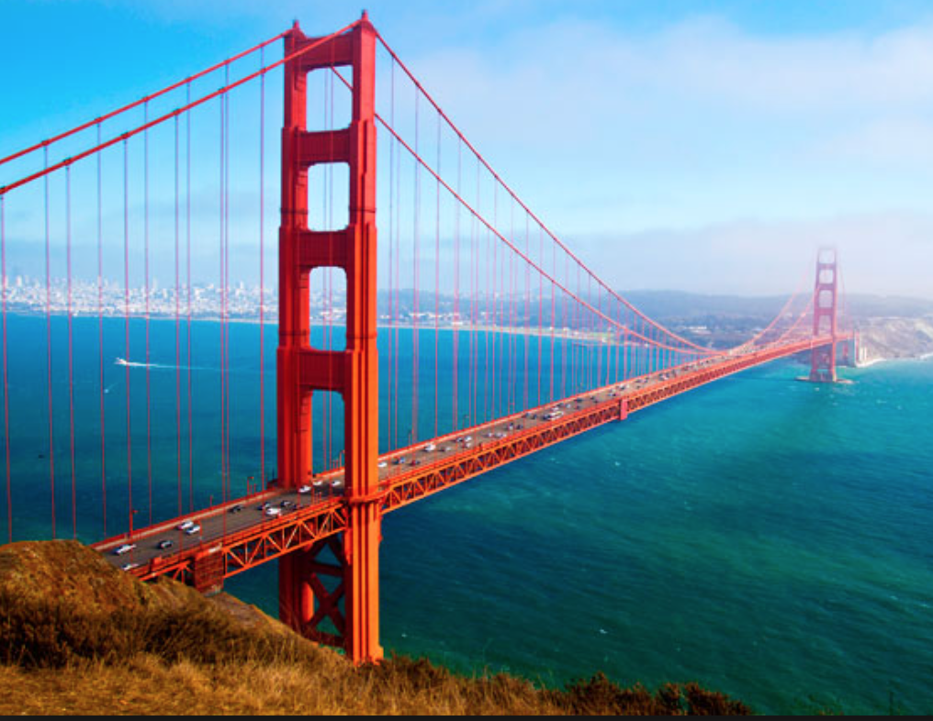
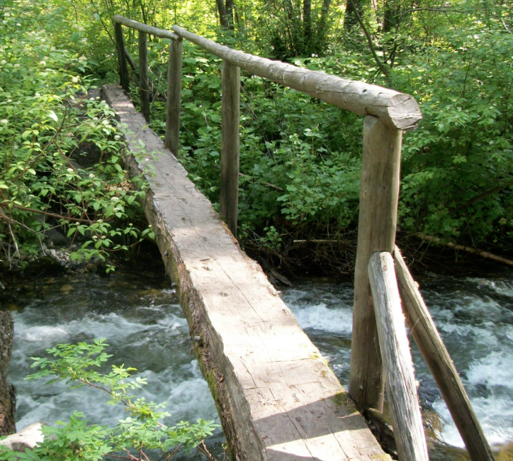
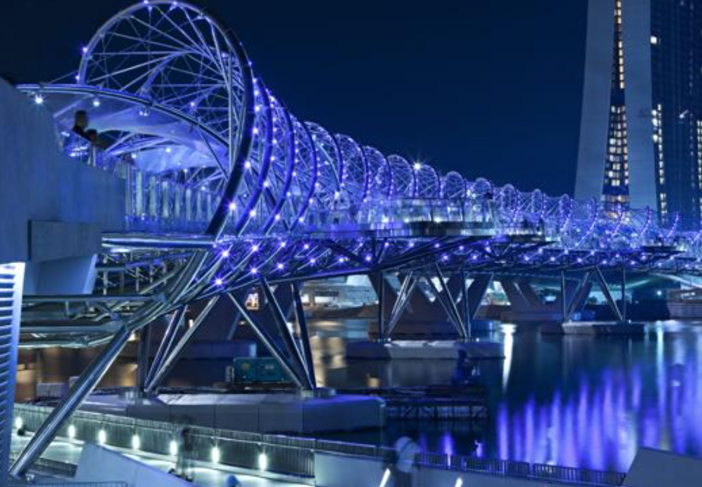
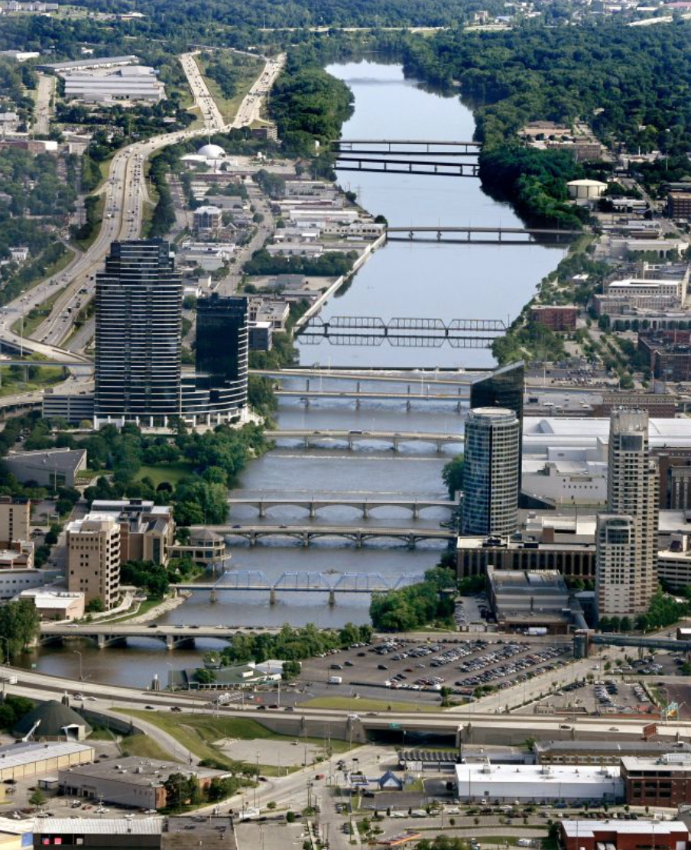
Connecting research and operations: hydrologic storylines for water resource planning+
Julie Vano, Ethan Gutmann, Joe Hamman, Martyn Clark, Andy Wood, Nans Addor, Andy Newman (NCAR)
Jeff Arnold (USACE)
Bart Nijssen, Oriana Chegwidden (University of Washington)
NCAR Water System Retreat
Boulder, Colorado, January 18, 2017
Notes:
http://cloudmind.info/amazing-bridges-of-the-world/
http://www.mlive.com/outdoors/index.ssf/2010/07/grand_river_expedition_to_find.html
HELIX BRIDGE, MARINA BAY AREA, SINGAPORE

Slide 2
Bridging the gap between research and operations
Usable products
Assessable information about those products
Appropriate guidance
Engaged practitioners
Effective feedback
Specific application: Hydrologic storylines
General guidance: Climate information dos and don’ts for water resources
Accessible information: factsheets, website
Growing the community
Why?
A single realization does not capture the three overarching uncertainties: (1) Human contributions to greenhouse gases and aerosols, (2) Ability to capture physical processes using models and how realistically they respond to changes in forcings, (3) Natural variability of systems.
Path forward
Use multi-model ensembles (MME), or in some cases perturbed physics ensembles (PPE). More realizations provide a better representation of possible futures. That said, more global climate model selected randomly is not necessarily better. Instead, identify models that span the range of possible futures for the impact of interest.
Frequently asked questions
How many climate projections should I use?
It depends on your risk tolerance…
When should I use multi-model averages v. individual models?
Use averages only when the impact is an average (e.g., shifts in seasonal hydrographs), use individual models for time series dependent impacts (e.g., floods)….
Real world examples...
Notes:
Context. What does a bridged gap look like?

Slide 3
Specific application:
Hydrologic Storylines
Why?
A single realization does not capture the three overarching uncertainties: (1) Human contributions to greenhouse gases and aerosols, (2) Ability to capture physical processes using models and how realistically they respond to changes in forcings, (3) Natural variability of systems.
Path forward
Use multi-model ensembles (MME), or in some cases perturbed physics ensembles (PPE). More realizations provide a better representation of possible futures. That said, more global climate model selected randomly is not necessarily better. Instead, identify models that span the range of possible futures for the impact of interest.
Frequently asked questions
How many climate projections should I use?
It depends on your risk tolerance…
When should I use multi-model averages v. individual models?
Use averages only when the impact is an average (e.g., shifts in seasonal hydrographs), use individual models for time series dependent impacts (e.g., floods)….
Real world examples...

Slide 4
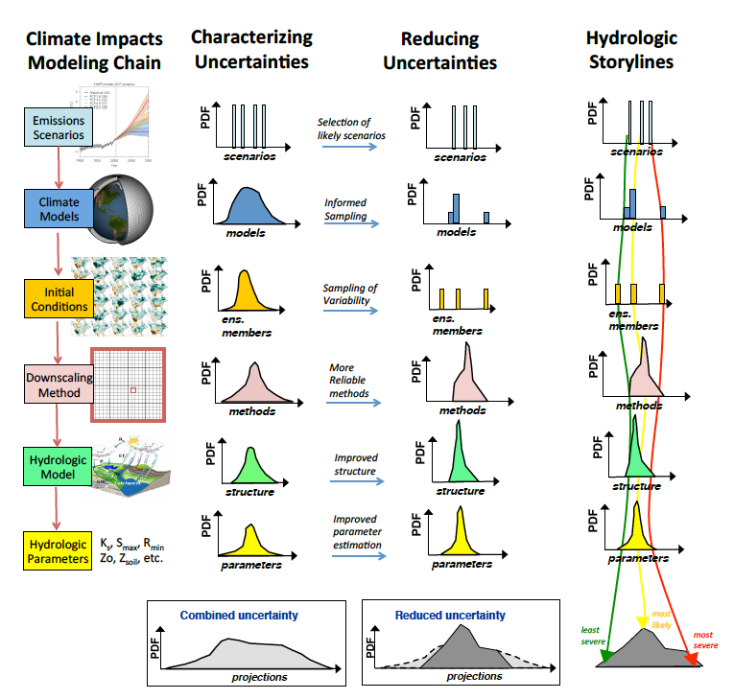
Quantitative hydrologic storylines concept
Explicitly estimate dominant sources of uncertainty in order to characterize the range of outcomes
What do these distributions really look like?
Reduce uncertainties
Sample from the range to construct storylines useful for water resources planning
Notes:
EMBRACING UNCERTAINTY
Consider model diversity, model fidelity, and model sensitivity.

Slide 5
Storylines demonstration project
Demonstration Project
(provisional data*)
2 x 40
10 x 8
1 x 80
2 x 40
1 x 80
2 x 40
80
% change annual flow
*Provisional data provided by the UW Hydro | Computational Hydrology Group at the University of Washington

Slide 6
Storylines demonstration project
Libby Reservoir, 2030-2079 relative to 1950-1999
Provisional data provided by the UW Hydro | Computational Hydrology Group at the University of Washington
% change annual flow
% change annual flow
Notes:
The short explanation is the bars are averages across each method. Each plot has all 80 runs, just averaged differently - e.g., the two RCP bars are averages of 40 simulations. The figure on the right is the distributions of those groupings.

Slide 7
Questions for demonstration project
Where is the majority of the variation coming from (e.g., GCMs or hydrologic model parameters)? Does this change with location or impact? If so, how?
Does storyline selection differ depending on (a) location, (b) impact, (c) number of storylines?
What is the optimal or minimum number of storylines?
With what confidence can we select storylines that reflect the range/min/max/average without running all the models?
Notes:
Another question: Can there be adequate coverage of uncertainty simultaneously at multiple (or all) locations?
With what confidence can we select storylines that reflect the range/min/max/average without running all the models?

Slide 8
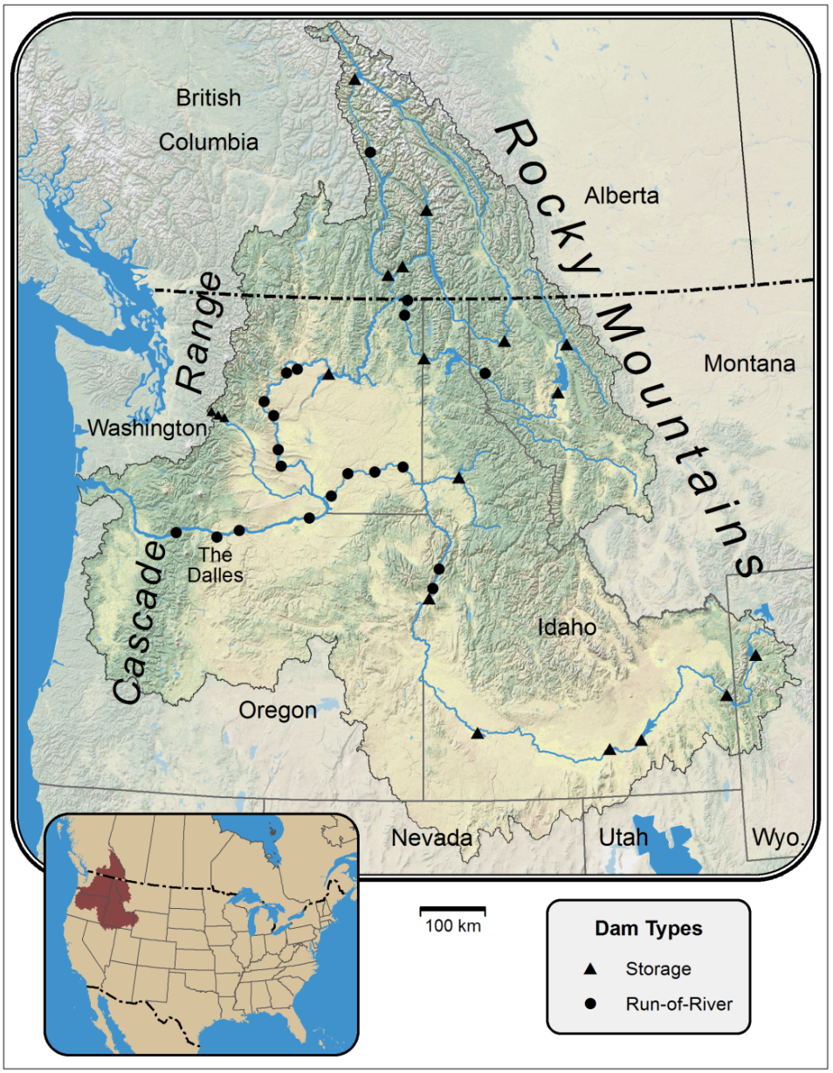
Demonstration of concept
Seattle, Walla Walla, and Portland District Offices, USACE providing feedback
Pacific Northwest locations: Libby and Dworshak
Libby
Figure: Robert Norheim, Climate Impacts Group
Dworshak
Notes:
Can there be adequate coverage of uncertainty simultaneously at multiple (or all) locations?
Leverages Andy’s work

Slide 9
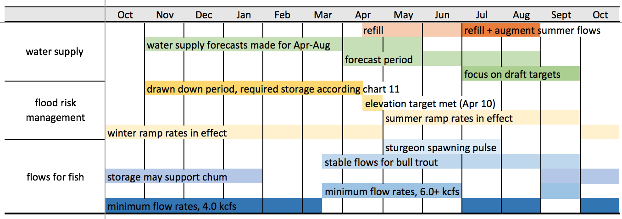
Decisions at Libby Reservoir
What water management decisions can be informed by the information storylines can provide?
Notes:
Are there ways to enhance this? (low-flow years example)
(seeking objective algorithms)
What measures quantify the most relevant climate impacts?

Slide 10
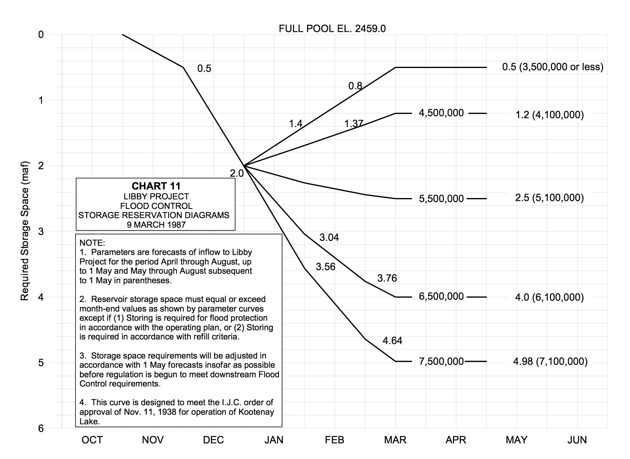
Storage Reservation Diagrams
Operation targets based on water supply forecasts from April to August. Chart 11 referenced in 2015 Water Operations Plan. We used it to categorize wet and dry years.

Slide 11
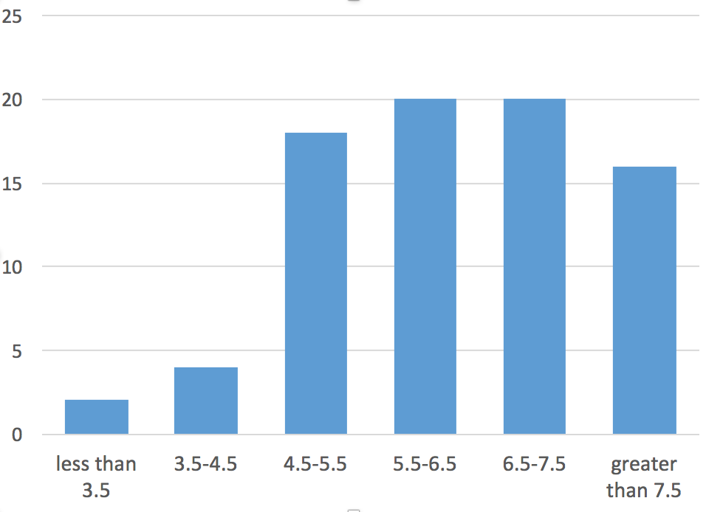
Specific measures for Libby (proposed)
Dry years
Metric: April-August inflow volume is less than 3.5 MAF, currently 2.5% of years
Change threshold: occurs twice as often, 5% of years or more
Ensemble outcome of interest: if doubling occurs in more than 10% of scenarios
April-August flow volumes for Libby (1928-2008)
count
5%+
forecast categories (MAF)
data from BPA, no regulation no irrigation

Slide 12
Specific measures for Libby (proposed)
Dry years
Wet years
Metric: April-August inflow volume is greater than 7.5 MAF, currently 20% of years
Change threshold: if this changes to 30% of years
Ensemble outcome: if greater than 30% of years occurs in half of the scenarios
April-August flow volumes for Libby (1928-2008)
30%+
count
forecast categories (MAF)
data from BPA, no regulation no irrigation

Slide 13
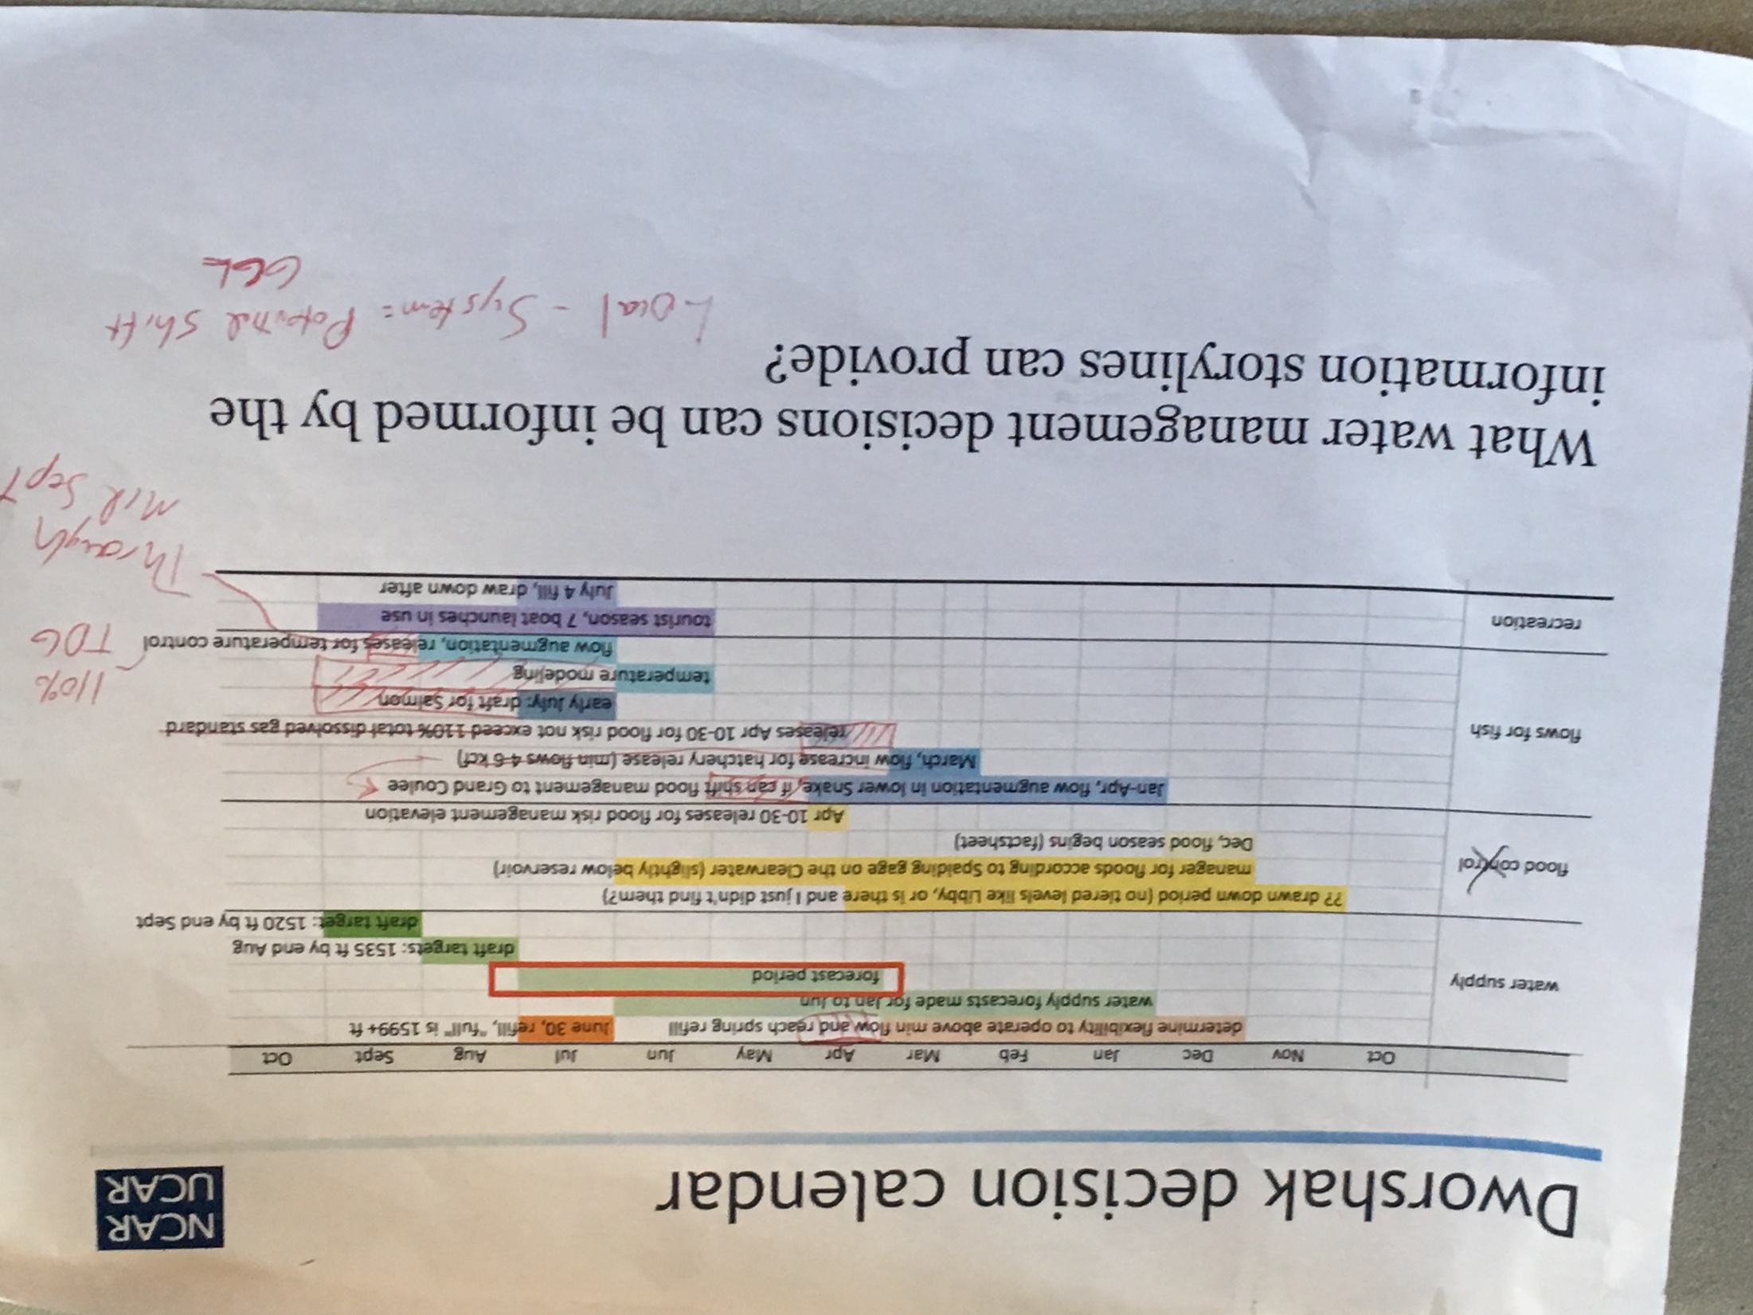
Conversations with operators
Multiple meetings helped us better understand their management challenges and determine what evaluations would be most valuable to their decision making. Important we started these conversations at the beginning.

Slide 14
Specific measures for Libby (revised)
Based on conversations with the Corps, re-binned:
dry years less than 4.8 MAF (left of brown line)
wet years greater than 7.5 MAF (right of blue line)
Where is the majority of the variation coming from (e.g., GCMs or hydrologic model parameters) for these impacts?
More coming soon…

Slide 15
General guidance:
Climate information dos and don’ts for water resources
Why?
A single realization does not capture the three overarching uncertainties: (1) Human contributions to greenhouse gases and aerosols, (2) Ability to capture physical processes using models and how realistically they respond to changes in forcings, (3) Natural variability of systems.
Path forward
Use multi-model ensembles (MME), or in some cases perturbed physics ensembles (PPE). More realizations provide a better representation of possible futures. That said, more global climate model selected randomly is not necessarily better. Instead, identify models that span the range of possible futures for the impact of interest.
Frequently asked questions
How many climate projections should I use?
It depends on your risk tolerance…
When should I use multi-model averages v. individual models?
Use averages only when the impact is an average (e.g., shifts in seasonal hydrographs), use individual models for time series dependent impacts (e.g., floods)….
Real world examples...
Notes:
slide from last project update meeting
What does a bridged gap look like?
Illustrate progress in these various all of the areas

Slide 16
Climate information dos and don’ts
Primary audience = water resource managers
Guiding principles (2)
Process recommendations (8)
Product recommendations
model selection (5)
interpreting results (6)
For each recommendation:
Why?
Frequently asked questions
Path forward
Examples
I. It is important to do something
II. Models can be helpful tools, if used appropriately
Process example:
Do plan for iterations as the first time you download data will likely not be your last
Model selection example:
Recognize that results from a single global climate model realization does not capture the full range of uncertainty
Interpretation example:
Only use routed streamflow as input to a reservoir model if it has been bias-corrected
Notes:
But will also be helpful for fellow researchers.
A format/framework where we can illustrate some of the conversations yesterday for the management audience.

Slide 17
Recommendation example Recognize that results from a single global climate model realization do not capture the full range of uncertainty
Why?
A single realization does not capture the three overarching uncertainties: (1) Human contributions to greenhouse gases and aerosols, (2) Ability to capture physical processes using models and how realistically they respond to changes in forcings, (3) Natural variability of systems.
Path forward
Use multi-model ensembles (MME), or in some cases perturbed physics ensembles (PPE). More realizations provide a better representation of possible futures. That said, more global climate model selected randomly is not necessarily better. Instead, identify models that span the range of possible futures for the impact of interest.
Frequently asked questions
How many climate projections should I use?
It depends on your risk tolerance…
When should I use multi-model averages v. individual models?
Use averages only when the impact is an average (e.g., shifts in seasonal hydrographs), use individual models for time series dependent impacts (e.g., floods)….
Real world examples...

Slide 18

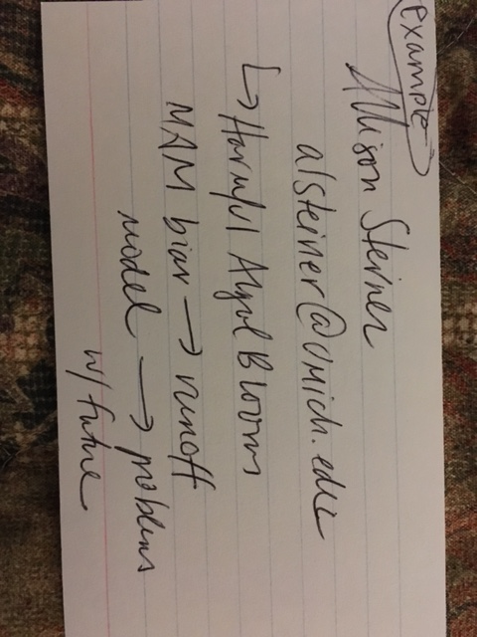

Collecting feedback
Collecting feedback on existing dos and don’ts, others dos and don’ts and examples, notecards above are from AGU Fall meeting.

Slide 19
Accessible information: factsheets, website

Slide 20
Concise summaries of tools, each include:
The challenge
How this tool faces this challenge
What are the scientific advances
What are the directions forward
Where one could go for more information

Slide 21
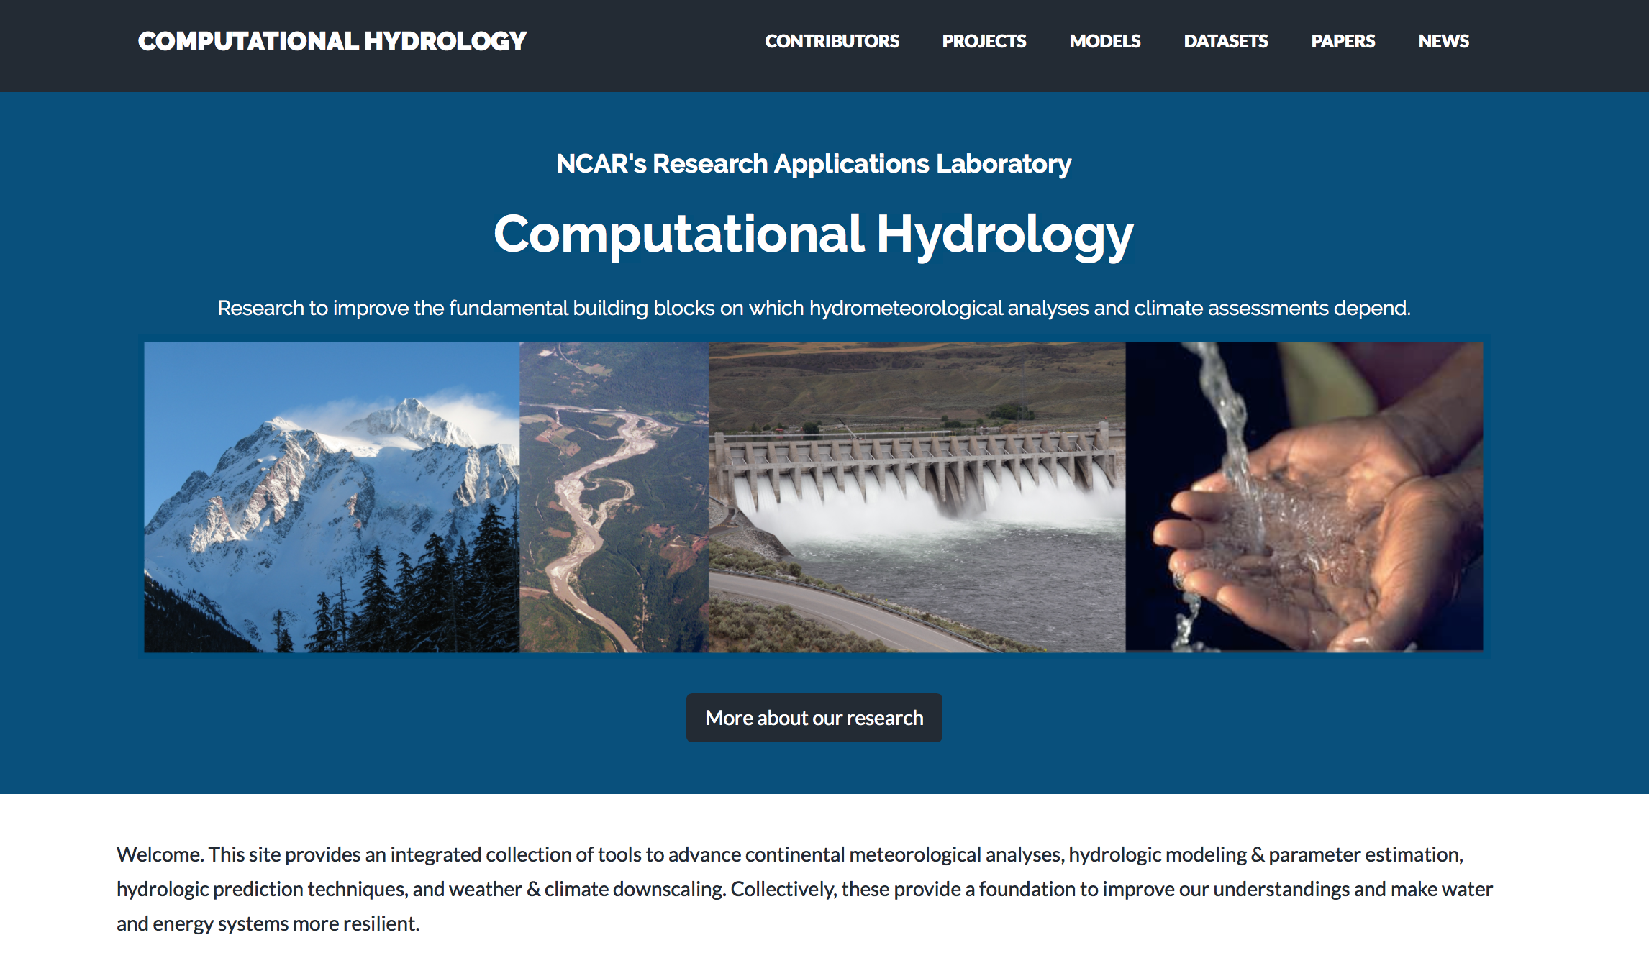
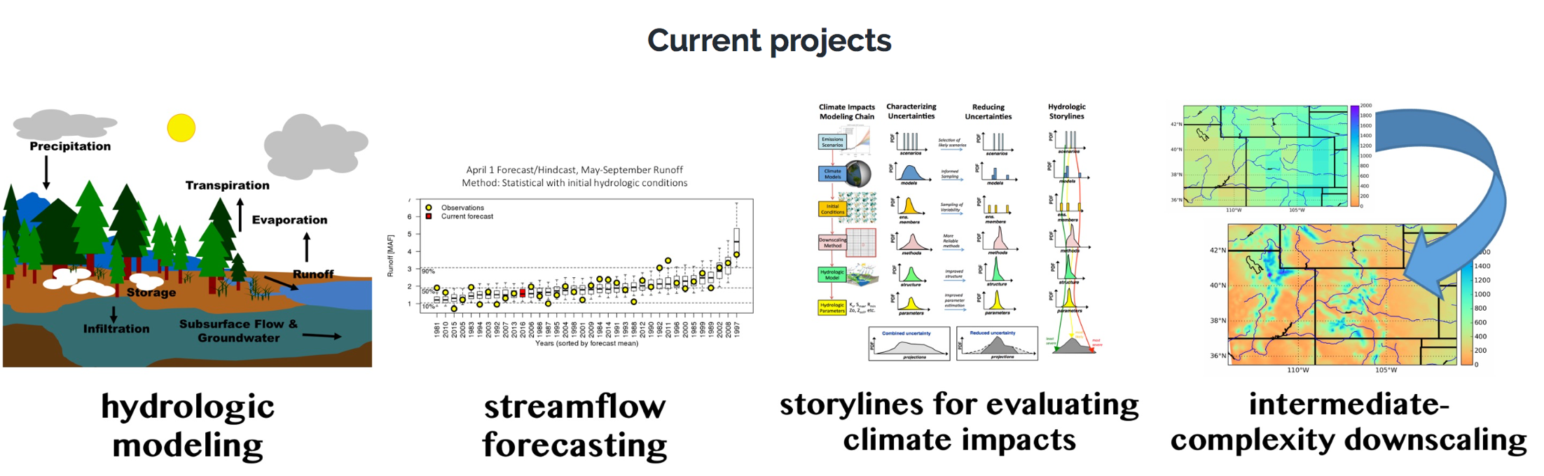
https://ral.ucar.edu/hap/computational-hydrology
Designed to make research more accessible in layers, particularly for USACE and Bureau partners

Slide 22
Growing the community

Slide 23
11 sessions at 2016 AGU Fall meeting
A press panel: “Integrating scientific research into local decision making”
2 networking events
A growing community of practice…

Slide 24
AGU’s growing community
TERMS USED
(e.g., co-design)
Preliminary estimate for 2016
Work done in collaboration with Daniel Ferguson (University of Arizona), David Behar (San Francisco Public Utility), Phil Mote (Oregon State), Rajul Pandya (AGU)
Notes:
Caveats:
2016 uses Fall Meeting schedule as its search engine.
Several terms did not work well with search algorithm and were not included (decision maker, co-development). Other terms were searched for only in the Public Affairs section (co-production, co-design, co-creation). Conservative estimate.
Stakeholder notably bigger, possibly a search engine difference, will re-evaluate once abstracts moved

Slide 25
Summary
Website
Hydrologic storylines
Factsheets
Strong
community
Thank you.
Questions, feedback?
jvano@ucar.edu
https://ral.ucar.edu/hap/computational-hydrology

Slide 26
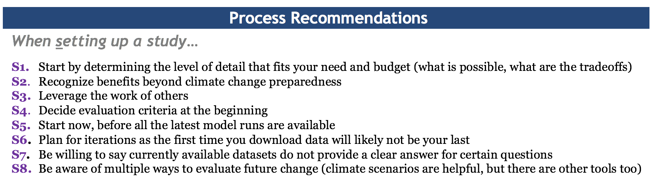
Dos and don’ts
Product Recommendations
When selecting models…
M1. Recognize that results from a single global climate model realization does not capture the full range of uncertainty
M2. Do not treat all global climate model runs equally
M3. Do not use a finer spatial resolution than what the models/data allow
M4. Do not use a temporal scale that the models/methods used cannot adequately simulate
M5. Recognize a single representation of hydrologic processes does not capture the full range of uncertainty
When interpreting the data…
D1. Do not focus on any single year or even single decade of global climate model output for determining the future climate response
D2. Only present future results as compared to the historical simulation for the same global climate model
D3. Avoid confusing grid-based output with routed streamflow
D4. Only use routed streamflow as input to a reservoir model if it has been bias-corrected
D5. Use analogies appropriately
D6. Do not get seduced by precision

